Slide 1
Stochastic Block Models
Gwangwoo Kim
Jan. 2, 2024

Slide 2
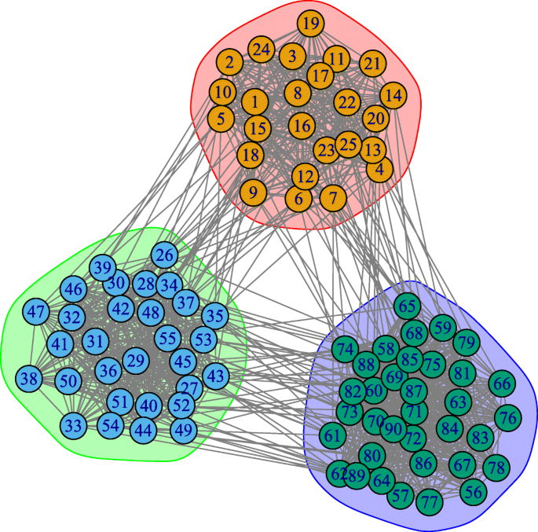
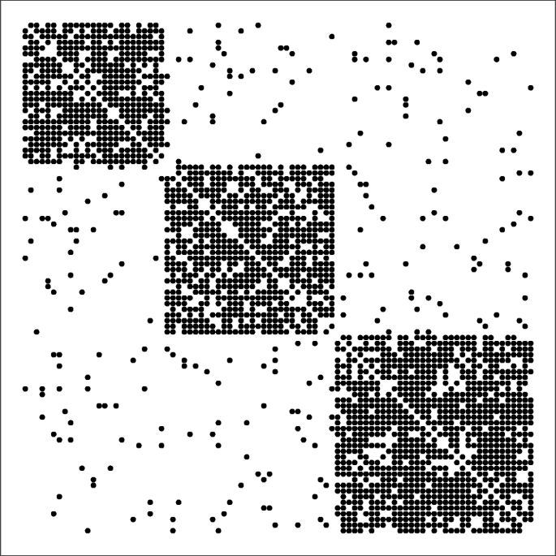
Introduction
Community detection is a clustering algorithm specially tailored for network analysis
Source: A review of stochastic block models and extensions for graph clustering

Slide 3
Stochastic Block Models (SBMs)
The objective is to partition the nodes into communities such that these assignments maximize the likelihood of the model according to the observed edges.
Setup:
N nodes
K communities (subgraphs)
K x K learnable matrix
N-length vector z (node-to-community assignment)
The adjacency matrix A=(a_ij)

Slide 4

Stochastic block models (SBMs)
Setup:
N nodes
K communities (subgraphs)
K x K learnable matrix
N-length vector z (node-to-community assignment)
The adjacency matrix A=(a_ij)
Model:
Training: Soon. (or any idea?)

Slide 5
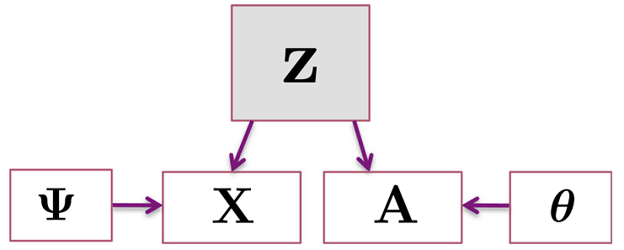
SBMs with multiple continuous attributes
Suppose we have attribute information X=(x_ip)
Denote Z (NxK) by a binary indicator matrix and z (Nx1) by the array labeling node-to-community assignments.
Assume connectivity and attributes are conditionally independent, given the community membership label.

Slide 6

SBMs with multiple continuous attributes
We assume each community i has an associated p-dimensional mean and covariance matrix .
Let
Then,

Slide 7
SBMs with multiple continuous attributes
We assume each community i has an associated p-dimensional mean and covariance matrix .
Let
Then,
And Daudin et al. showed

Slide 8



Training step
EM algorithm
E-step: For the probability of node i belonging to community c
M-step:

Slide 9
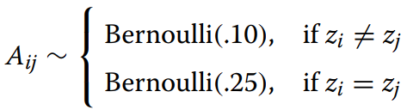



Synthetic data results
Setup:
N = 200
K = 4
For each c, and

Slide 10
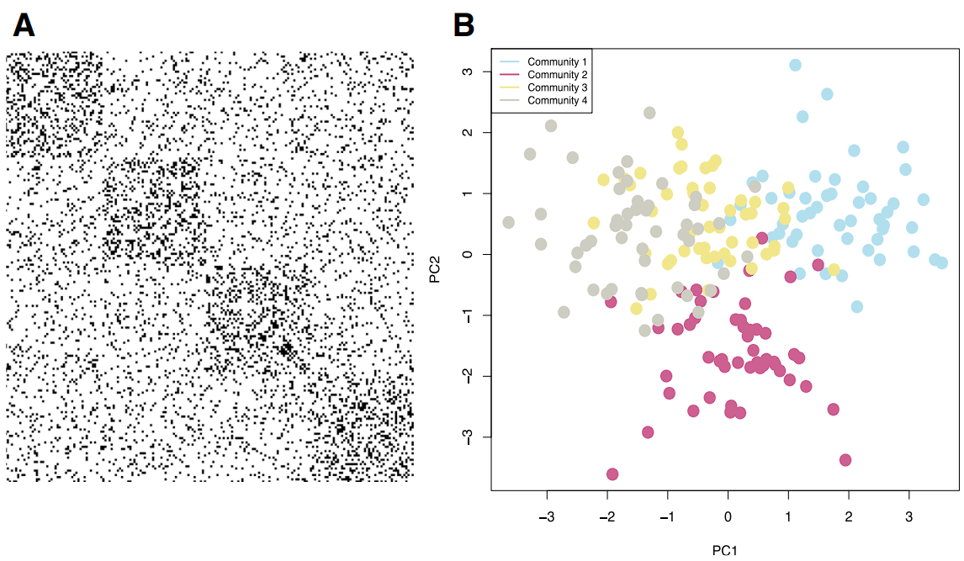
Synthetic data results
 | NMI
SBM (without X) | 0.65
GMM (without A) | 0.68
Proposed (with X and A) | 0.83

Slide 11
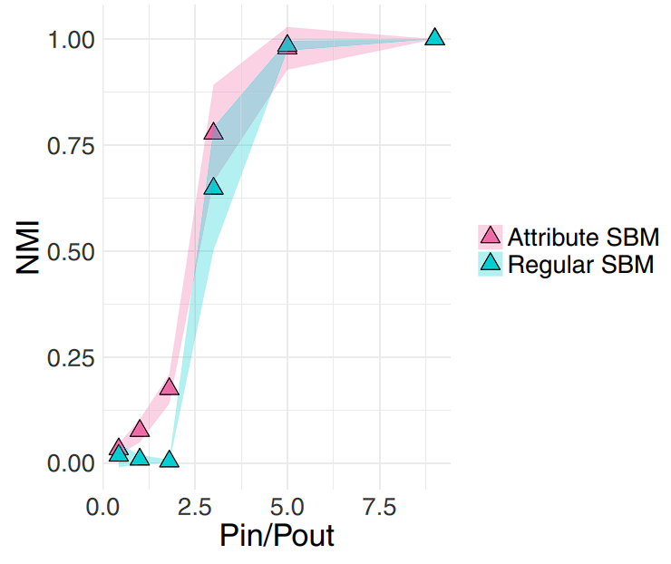
Synthetic data results

Slide 12
Real-world dataset
Microbiome Subject Similarity Network
121 nodes
5-dimensional attribute vector
Protein interaction network
82 nodes
6-dimensional attribute vector

Slide 13
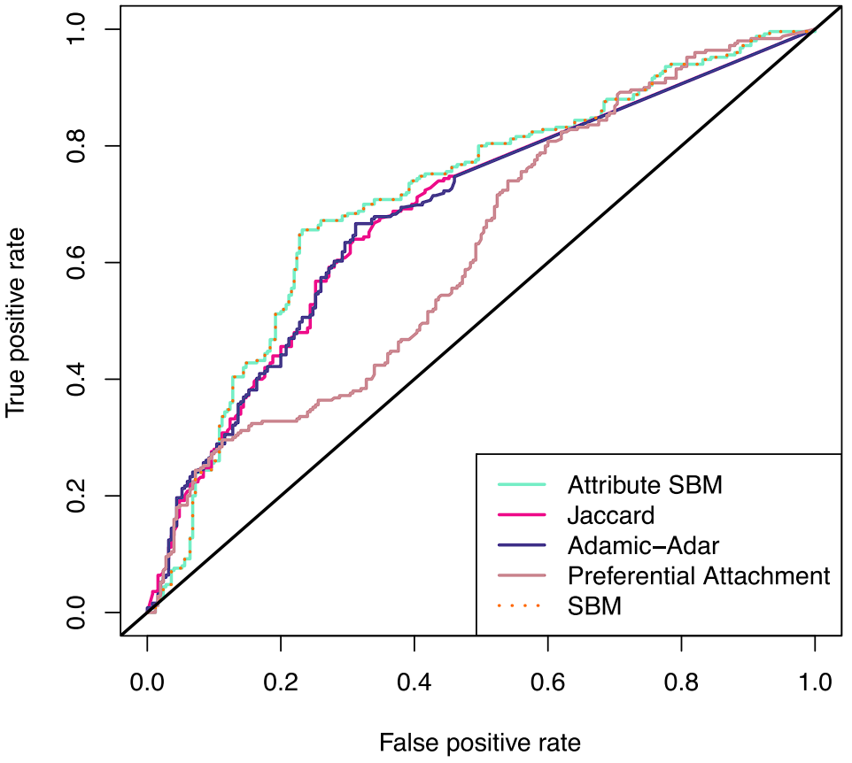
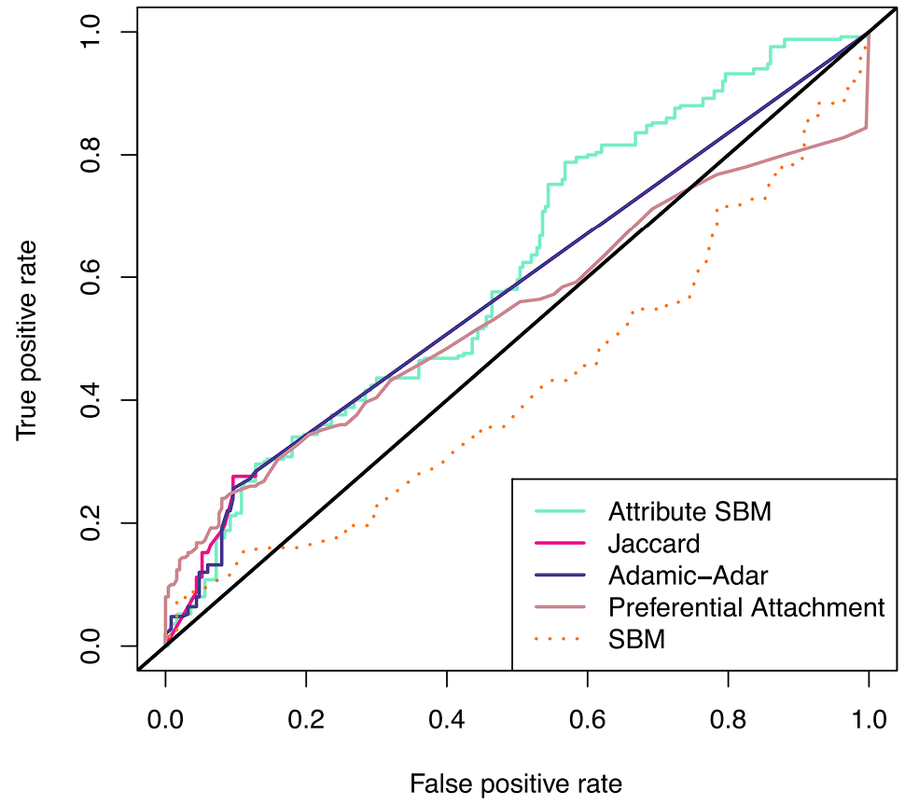
Link prediction experiments

Slide 14
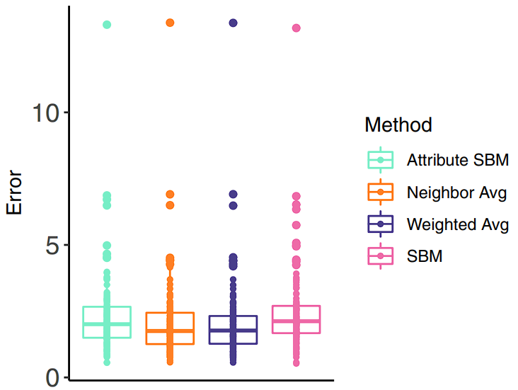
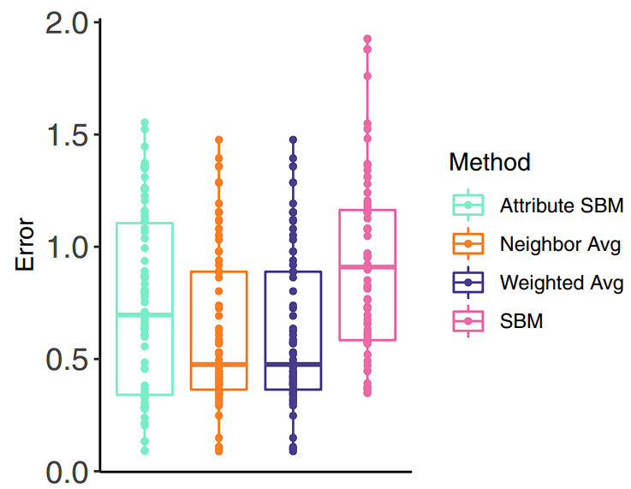
Collaborative filtering experiments

Slide 15
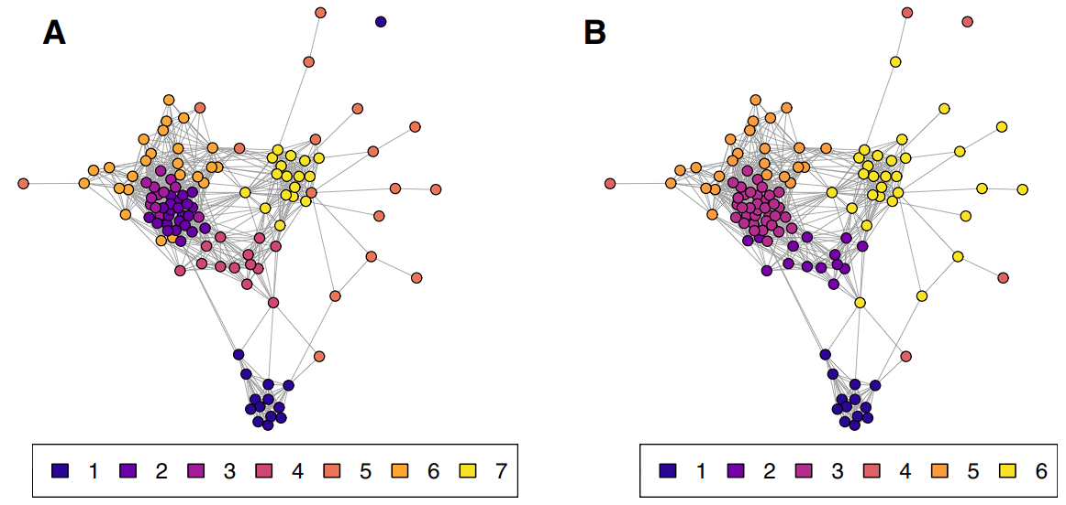
Community detection

Slide 16
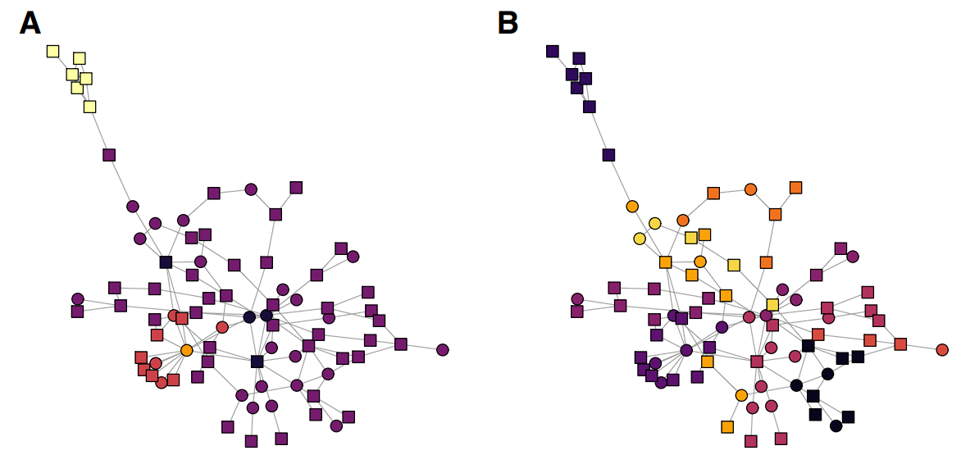
Community detection

Slide 17
Future work
How to determine the number of communities?
How to handle a combination of multiple discrete and continuous attributes?
Relationship between ours and I-Louvain method.
Did not consider corrections for heterogeneous degrees, or the effect of partial dependency between attributes and connectivity.

Slide 18
References
Lee, C., Wilkinson, D.J. A review of stochastic block models and extensions for graph clustering. Appl Netw Sci 4, 122 (2019). https://doi.org/10.1007/s41109-019-0232-2

Slide 19
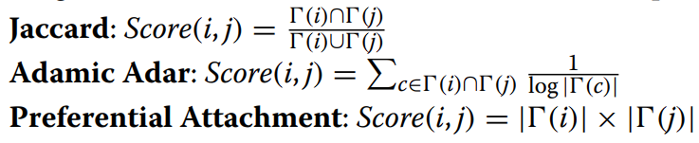
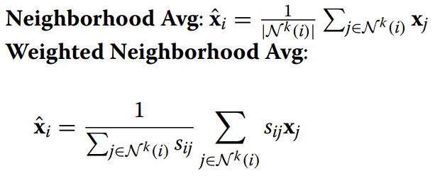
Appendix
Three common link prediction methods
Two common collaborative filtering approaches

